Slide 1


Software Logging and Observability
Bachar RIMA
Equipe MAREL En collaboration avec Berger-Levrault
07/11/2023

Slide 2

Table of Contents
Software Logging
Background
Context
Problem Statement
SoftScanner
Motivation
Roadmap
Feature Model
Architecture
Workflow
Event-based GUI Widgets Logging Strategy
Software Observability
Limitations of Software Logging
Introduction
Metrics
Traces
Logs
Industry Standards
OpenTelemetry Tracing with Zipkin (Demo)
Software Logging and Observability
2

Slide 3
Software Logging – Background (1)
How can we know what led a program to fail?
How can we know what happened when a system is hacked/breached by an unauthorized party?
How do we know which parts of our program require the most computation power, memory usage, storage capacity, I/O bandwidth, etc.?
How do we know which parts of our system are mostly used and require optimization/scaling?
How do we know which users of website prefer a specific product over another?
Etc.
First Answer: use printing statements with different values depending on the event and its context. We say these printing statements leave logs behind them in the console, allowing us to understand what happened.
Software Logging and Observability
3

Slide 4
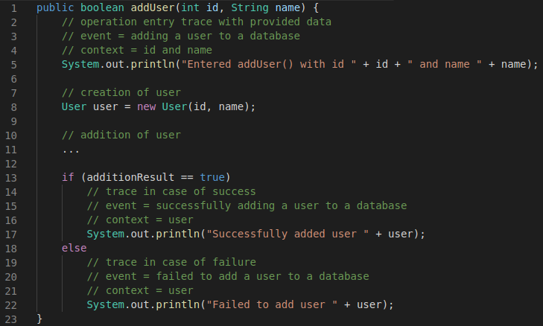
Software Logging – Background (2)
Software Logging and Observability
4

Slide 5
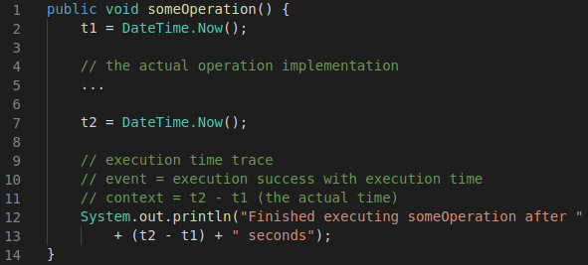
Software Logging – Background (3)
Software Logging and Observability
5

Slide 6
Software Logging – Background (4)
Problems with traditional printing statements
Ephemeral: once the application is done executing, the printed statements are cleared from the console.
No verbosity/criticality control: not all messages need to be printed for all events in all scenarios. For example, in a production environment we only want to see information about the flow of the application (e.g., progress details) while filtering debugging information that are usually available in a development/testing environment.
No printing message distribution: printed statements are only displayed in the standard output/error console. They cannot be dispatched to other destinations simultaneously.
Solution: use logging utilities which can overcome all the above limitations (e.g., java.util.logging, Log4J, SLF4J, etc.) by injecting Log Printing Statements (LPSs) into a project’s code.
Software Logging and Observability
6

Slide 7
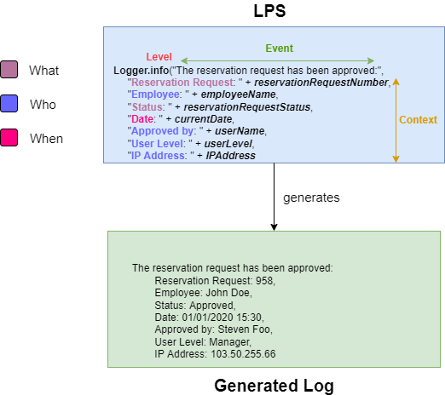
Software Logging – Context: What is logging?
Log Printing Statements (LPSs): logging operations injected into a system's source code to extract information related to the fulfillment of a logging goal and generating logs that would be further analyzed to react accordingly.
LPS event: the event captured by an LPS.
LPS context: the actual programming elements (variables, method calls, etc.) used to build the LPS event’s context, generally consisting of five parts:
Who: who triggered the event
When: when was the event triggered
Where: where the event was trigged (e.g., GUI widget)
What: what event information to retrieve (i.e., event type and other event-related data)
Why: why was the event triggered.
LPS level: the criticality of the generated log, controlling what kind of information will be included in each part of the LPS event.
Software Logging and Observability
7

Slide 8
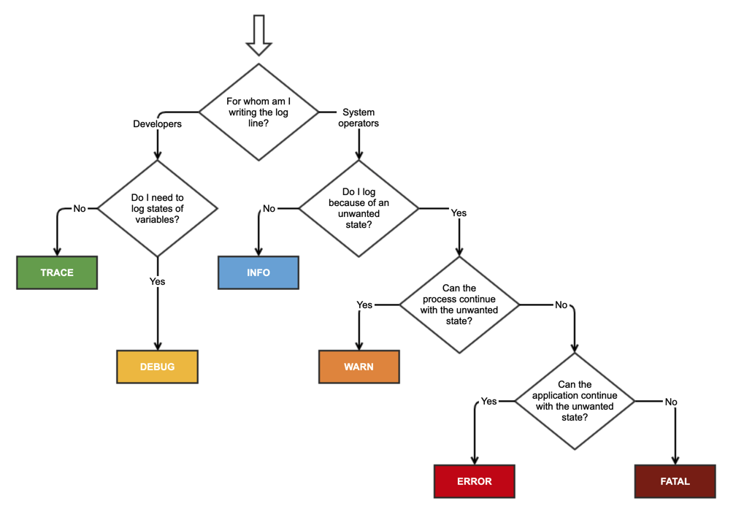
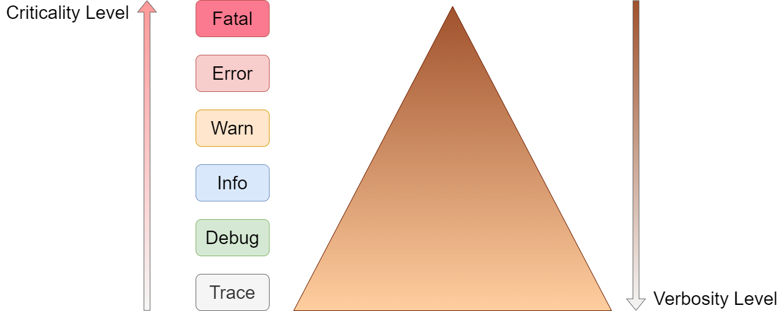
Software Logging – Context: LPS Criticality Level
https://stackoverflow.com/questions/2031163/when-to-use-the-different-log-levels
Software Logging and Observability
8

Slide 9
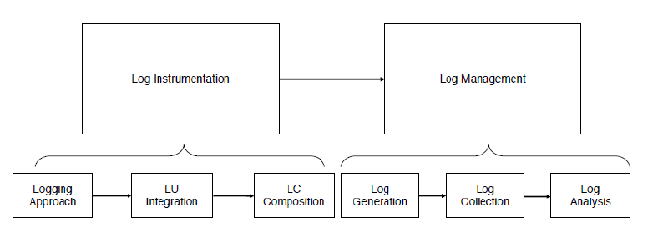
Software Logging – Context: The Logging Process
Chen, B. (2020). Improving the Logging Practices in DevOps.
Software Logging and Observability
9

Slide 10
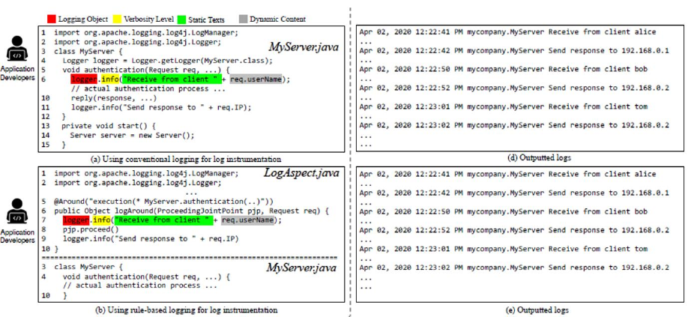
Software Logging – Context: Logging Approaches (1)
Conventional Logging: free-form logging with the logging code, scattered across the codebase and tangled with the feature code.
Rule-based Logging: free-form logging with the logging code, modularized into separate files (e.g., Aspect-Oriented logging).
Chen, B. (2020). Improving the Logging Practices in DevOps.
Software Logging and Observability
10

Slide 11
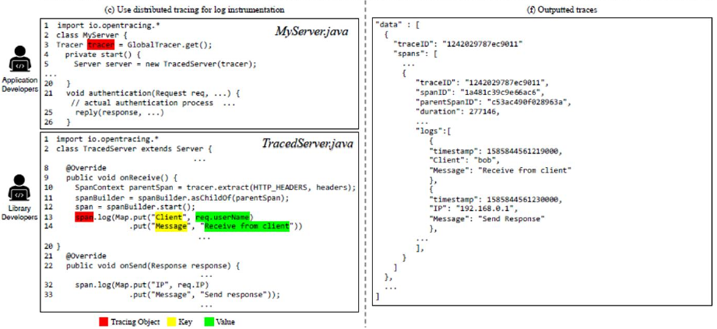
Software Logging – Context: Logging Approaches (2)
Distributed Tracing: structured logging using end-to-end traces to capture the full picture across multiple machines and processes in a distributed system (e.g., OpenTracing API, Dapper by Google, …)
Chen, B. (2020). Improving the Logging Practices in DevOps.
Software Logging and Observability
11

Slide 12
Software Logging – Context: Logging Approaches (3)
Dimension/Logging Approach | Conventional Logging | Rule-based Logging | Distributed Tracing
Who | SUS developers | SUS developers | Logging Library developpers
Filtering | Verbosity Level | Verbosity Level | Sampling
Format | Free Form | Free Form | Structured
Domain | General | General | Distributed Systems
Flexibility | High | Low | Medium
Scattering | High | Low | Low
Chen, B. (2020). Improving the Logging Practices in DevOps.
Software Logging and Observability
12

Slide 13
Software Logging – Context: Logging Approaches (4)
Problems:
“The majority of software project still adopt conventional logging approaches” (Chen & Jiang (2020), Studying the Use of Java Logging Utilities in the Wild).
“Steep learning curve of the other approaches” (Chen, B. (2020). Improving the Logging Practices in DevOps).
Active research question: “How to suggest the appropriate logging approach(es) for a System under Study (SUS)’s specific logging scenarios and logging goals?”
Software Logging and Observability
13

Slide 14
Software Logging – Context: Logging Utilities Integration
Evolution over the years: from simple printf() statements to more complex and commonly-used libraries:
Java: SLF4J, Log4j, …
C++: Spdlog, …
New features: persistence, thread-safety, verbosity levels, formatting, …
Different LU(s) provide different functionalities → developers may integrate one/many existing general-purpose or specialized LU(s), or even develop their own depending on the usage context.
Each project may contain one or more LU(s), each providing many different configuration options → developers may need to properly configure the LU(s) to gather enough data to:
Gain full visibility of the SUS
Minimize the performance overhead and storage requirements.
Active research questions:
“Which LU(s) should be used, given a SUS?”
“How to migrate to other/newer LU(s), given a SUS?”
“How to automate the configuration management across multiple LU(s), given a SUS?”
Software Logging and Observability
14

Slide 15
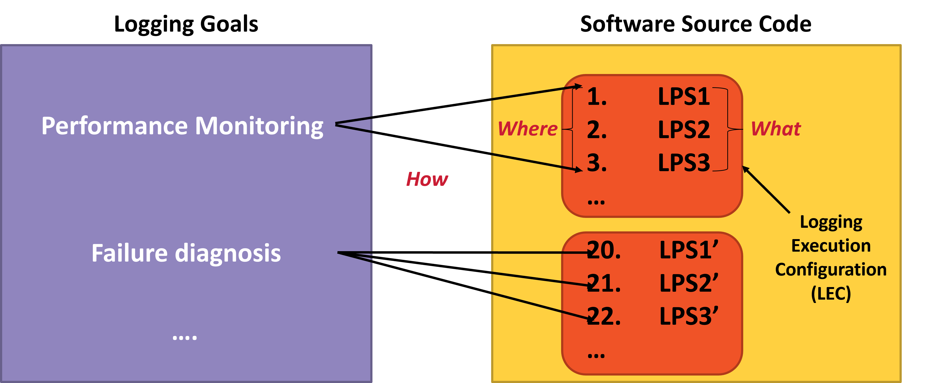
Software Logging – Context: Logging Code Composition
Where to Log: determine the appropriate logging points in the source code to inject LPSs.
What to Log: determine how to build the LPSs (event, context, criticality)
How to Log: choose a logging strategy to inject the LPSs into their appropriate logging points.
Software Logging and Observability
15

Slide 16
Software Logging – Problem Statement: Guidelines & Automation
Very few systematic guidelines on log instrumentation exist, even fewer are applied in practice.
Automated approaches for log instrumentation exist, but they are mostly partial or costly:
Handling one logging goal at a time.
Don’t necessarily address all aspects of logging code composition:
Where to log only;
What to log only;
What log levels to use only;
Any incomplete combination of the above.
Software Logging and Observability
16

Slide 17
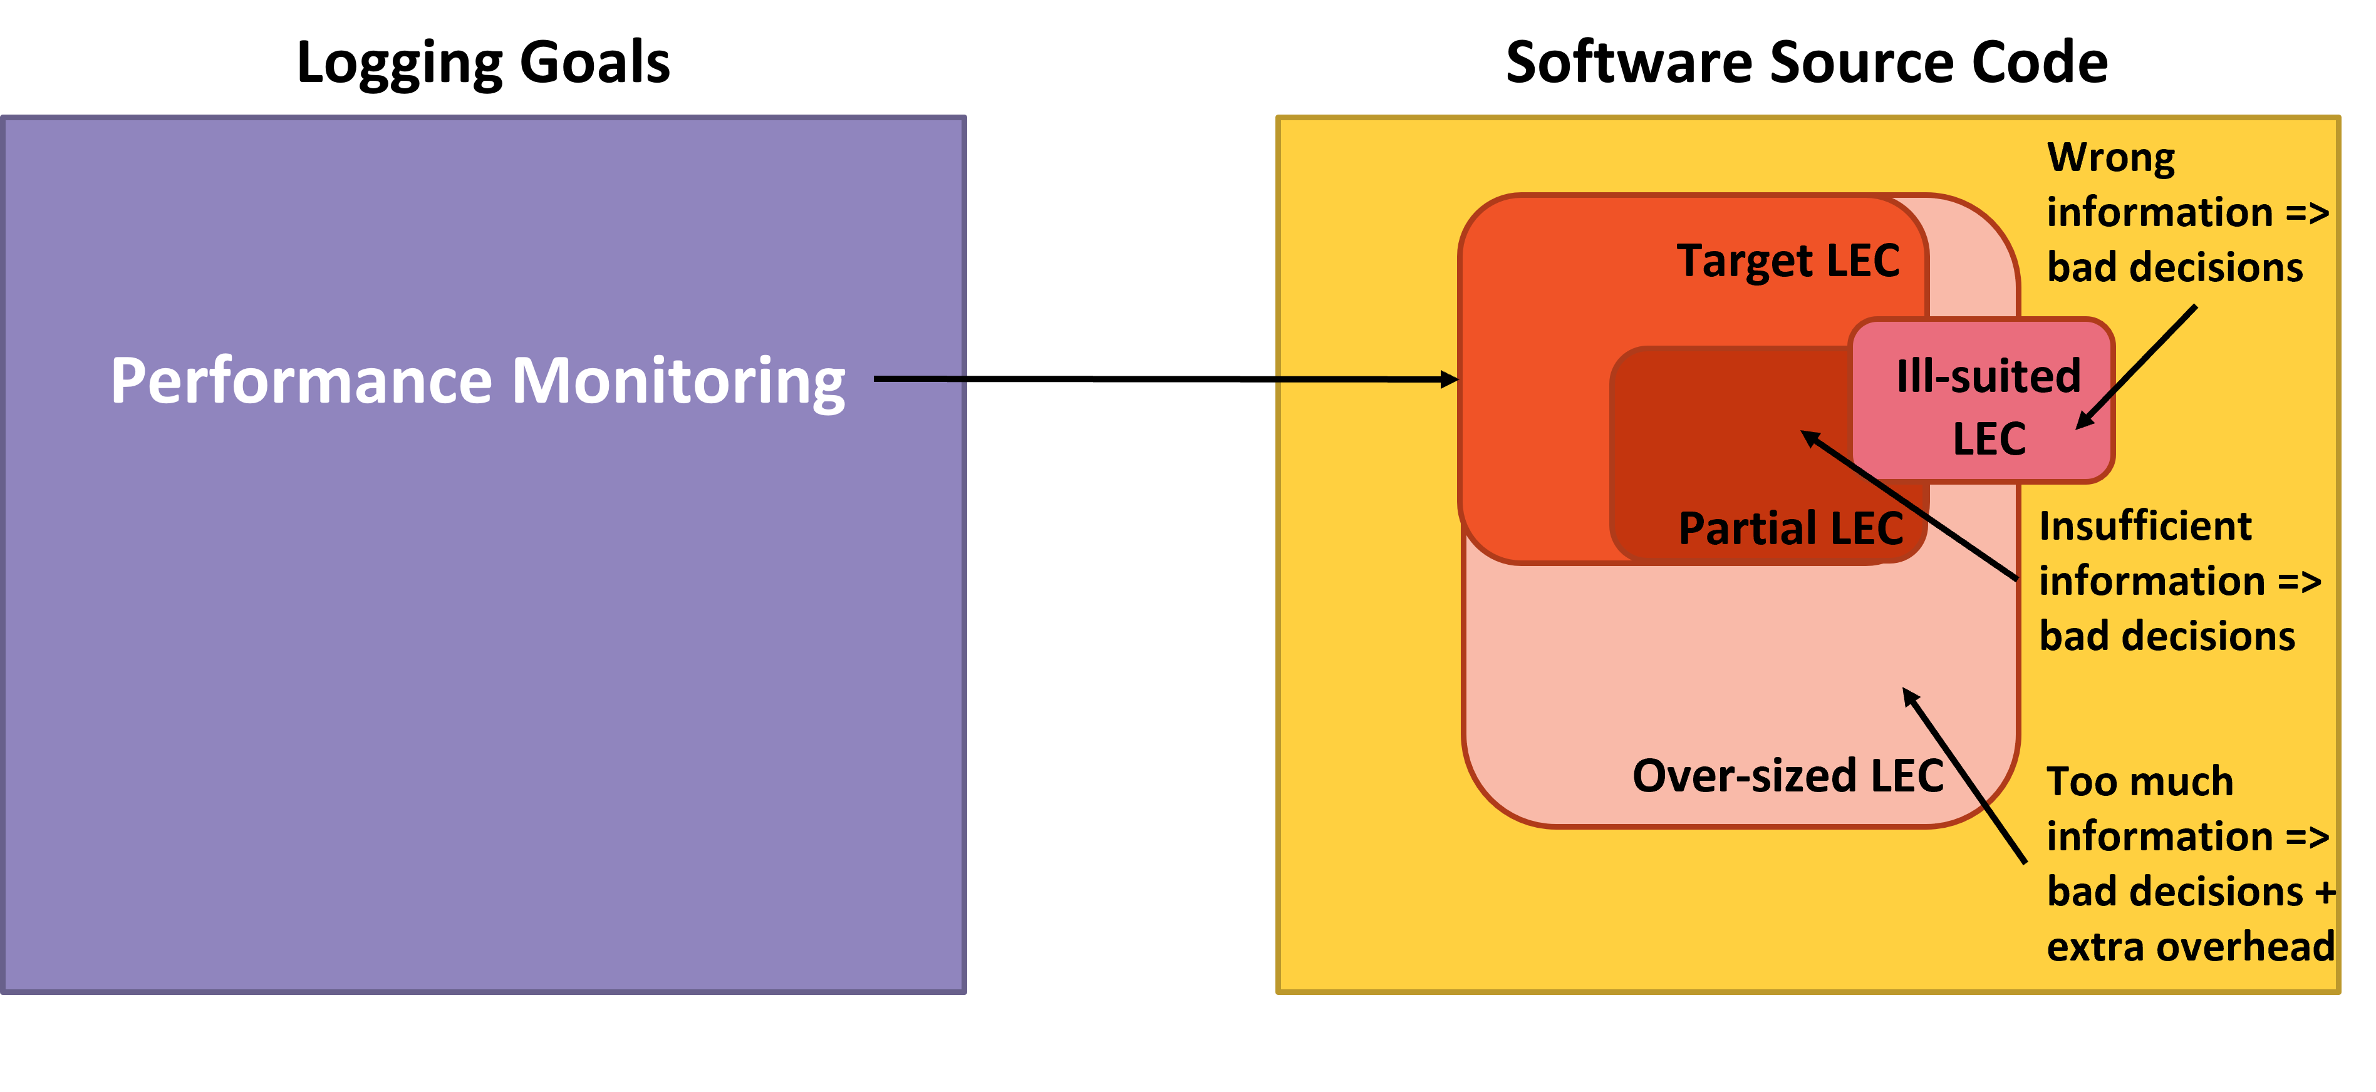
Software Logging – Problem Statement: Coverage Mismatch between Logging Goals and LECs
Software Logging and Observability
17

Slide 18
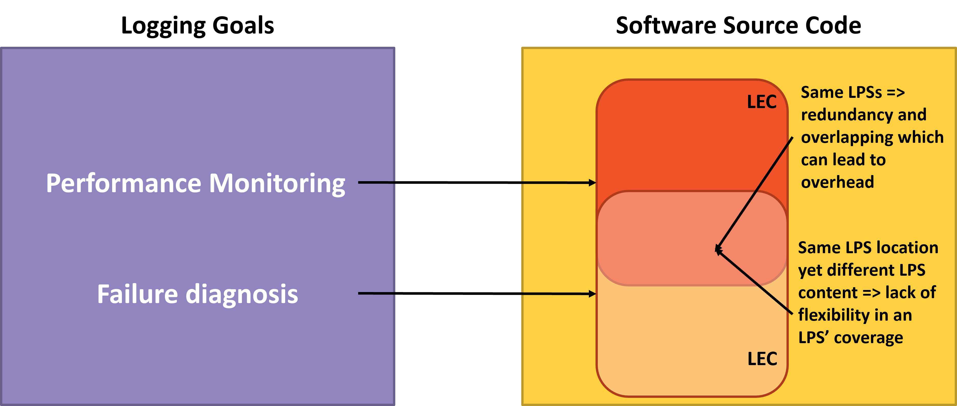
Software Logging – Problem Statement: Flexibility, Overlapping, and Redundancy of LPSs
Software Logging and Observability
18

Slide 19
SoftScanner – Motivation
Very few systematic guidelines on log instrumentation exist, even fewer are applied in practice → need for more automation to reduce developer effort and error
Automated approaches for log instrumentation exist, but they are mostly partial or costly:
Handling one logging goal at a time → need for logging support for multiple logging goals at once
Need for an approach covering all aspects of LPS composition (where, what, how, and at which level)
Non-optimal coverage for a logging goal by an LEC may result in bad decisions, and possibly extra overhead → need for optimization mechanisms to generate LECs that optimally cover their logging goals
Redundant and overlapping LPSs may lead to overhead and lack of flexibility → need for optimization mechanisms to handle redundant and overlapping LPSs
Software Logging and Observability
19

Slide 20
SoftScanner – Overview
SoftScanner is a log-centric, software analysis and engineering ecosystem
SoftScanner is semi-automatic → need for more automation to reduce developer effort and error
Softscanner supports a multi-logging-goal-based log instrumentation approach → need for logging support for multiple logging goals at once
SoftScanner provides different logging strategies to build LECs for specific logging goals, with different criticality level output filters, while establishing a bi-directional link between the LPSs and their corresponding logs → need for an approach covering all aspects of LPS composition (where, what, how, and at which level)
SoftScanner provides an LPS optimizer component to deal with redundancy, overlapping, covering mismatch scenarios, and other LPS-related optimization issues →
need for optimization mechanisms to generate LECs that optimally cover their logging goals
need for optimization mechanisms to handle redundant and overlapping LPSs
Software Logging and Observability
20

Slide 21
SoftScanner – Roadmap (1)
Axis 1: logging goals & LECs
Axis 2: Static optimization of LECs
Make a feature model of all possible logging goals
Select logging goals of interest
Implement at least one logging strategy for each logging goal of interest
Goal: Perform static generation of optimal LECs for multiple logging goals at once
Approach: Implement different optimization techniques that balance the trade-off between reducing LEC costs and maximizing its logging goal’s degree of fulfillment
Software Logging and Observability
21

Slide 22
SoftScanner – Roadmap (2)
Axis 3: Dynamic optimization of LECs
Axis 4: Model-Driven-Engineering-based generation of LECs
Goal: Allow a dynamic generation of LECs where data collection points can be enabled, disabled, and/or defined on the run to fulfill a given set of tracing goals
Approach: Apply information dynamic analysis and coding techniques that allow the dynamic enabling, disabling, and definition of LPSs
Goal: Make the approach platform-independent by generalizing concepts tackled in the previous axes and making them model-driven using MDE
Approach: Define and reuse a set of metamodels covering the relevant domains (source code, LECs, LPSs, logging goals, …) as well as the necessary mapping rules between them
Software Logging and Observability
22

Slide 23
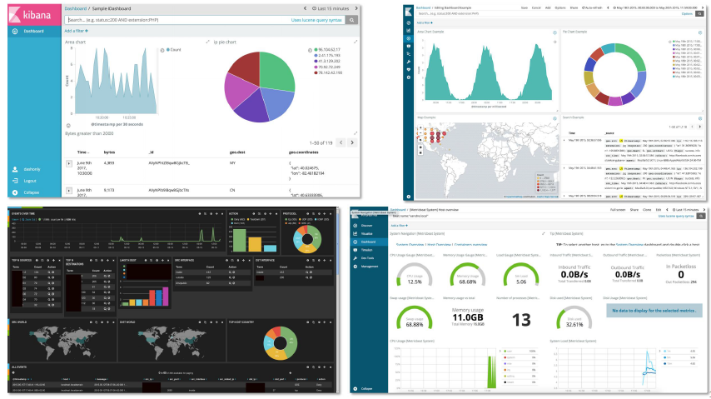
SoftScanner – Roadmap (3)
Axis 5: Interactive visual platform for LEC adaptation
Goal: Allow operators to directly adapt LECs with respect to the desired logging goals.
Approach: Examine existing interactive visualization platforms (e.g., Kibana dashboard) and identify their limitations, then propose a solution to palliate them and integrate it to the project
Software Logging and Observability
23

Slide 24
SoftScanner – Feature Model (1)
SoftScanner
0
Assisting in Troubleshooting
Tracking Execution status
Assisting in Comprehension
Book-keeping
1
Based on H. Li et al. (2020). A Qualitative Study of the Benefits and Costs of Logging from Developers' Perspectives.
Software Logging and Observability
24

Slide 25
SoftScanner – Feature Model (2)
SoftScanner
0
Assisting in Troubleshooting
Tracking Execution status
Assisting in Comprehension
Book-keeping
1
Runtime Diagnosis
User/Customer troubleshooting
Debugging
2
Configuration
Field
Test
Performance
Security
Production
Development
3
Software Logging and Observability
25

Slide 26
SoftScanner – Feature Model (3)
SoftScanner
0
Assisting in Troubleshooting
Tracking Execution status
Assisting in Comprehension
Book-keeping
1
Execution progress
Alerting & Monitoring
2
Immediate feedback
Ongoing event status
System liveness status
Real-time alerting
Anomaly detection
Log monitoring
Performance monitoring
3
Software Logging and Observability
26

Slide 27
SoftScanner – Feature Model (4)
SoftScanner
0
Assisting in Troubleshooting
Tracking Execution status
Assisting in Comprehension
Book-keeping
1
System comprehension
Assisting in software development
2
Code familiarization
System runtime familiarization
Real vs. Expected system behavior verification
Detecting code smells
Suggesting better coding practices
3
Major runtime events
Use-case Scenario dynamics
Logging events contextualization
Internal state communication
4
Software Logging and Observability
27

Slide 28
SoftScanner – Feature Model (5)
SoftScanner
0
Assisting in Troubleshooting
Tracking Execution status
Assisting in Comprehension
Book-keeping
1
Runtime statistics
Auditing
2
Software Logging and Observability
28

Slide 29
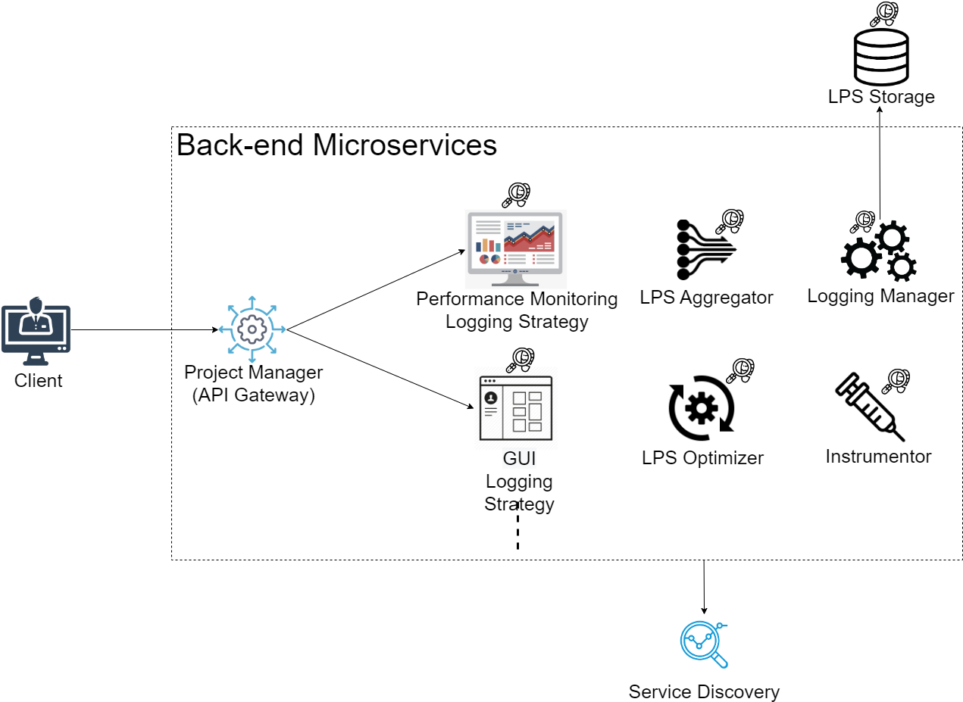
SoftScanner – Logging Instrumentation Architecture
Software Logging and Observability
29

Slide 30
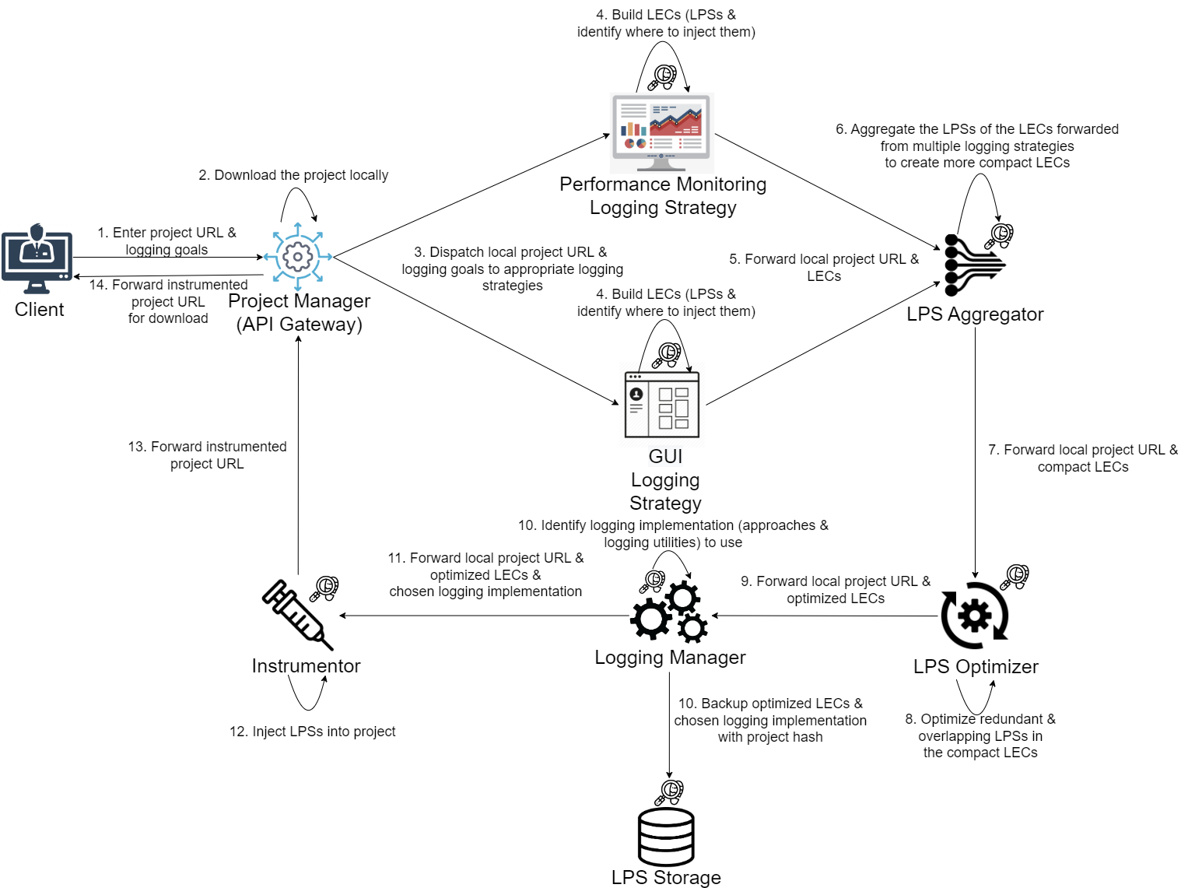
SoftScanner – Logging Instrumentation Workflow
Software Logging and Observability
30

Slide 31
SoftScanner – Event-based GUI Widgets Logging (1)
Goal: provide a logging mechanism for GUI widgets of Angular projects.
Methodology: given a set of target events, automatically log all widgets upon which these events can be triggered.
Currently supported events:
Click: clickable widgets
Submit: form submissions (ngSubmit for Angular)
Href: hyper-linkable widgets (+ routerLink for Angular)
FocusOut: meaningfully focusable widgets (e.g., <input> widgets like text fields, …, <textarea> widgets, …)
Change: meaningfully changeable widgets (e.g., <select> drop-down lists, <input> widgets like checkboxes, radio buttons, …)
File: file uploads
Software Logging and Observability
31

Slide 32
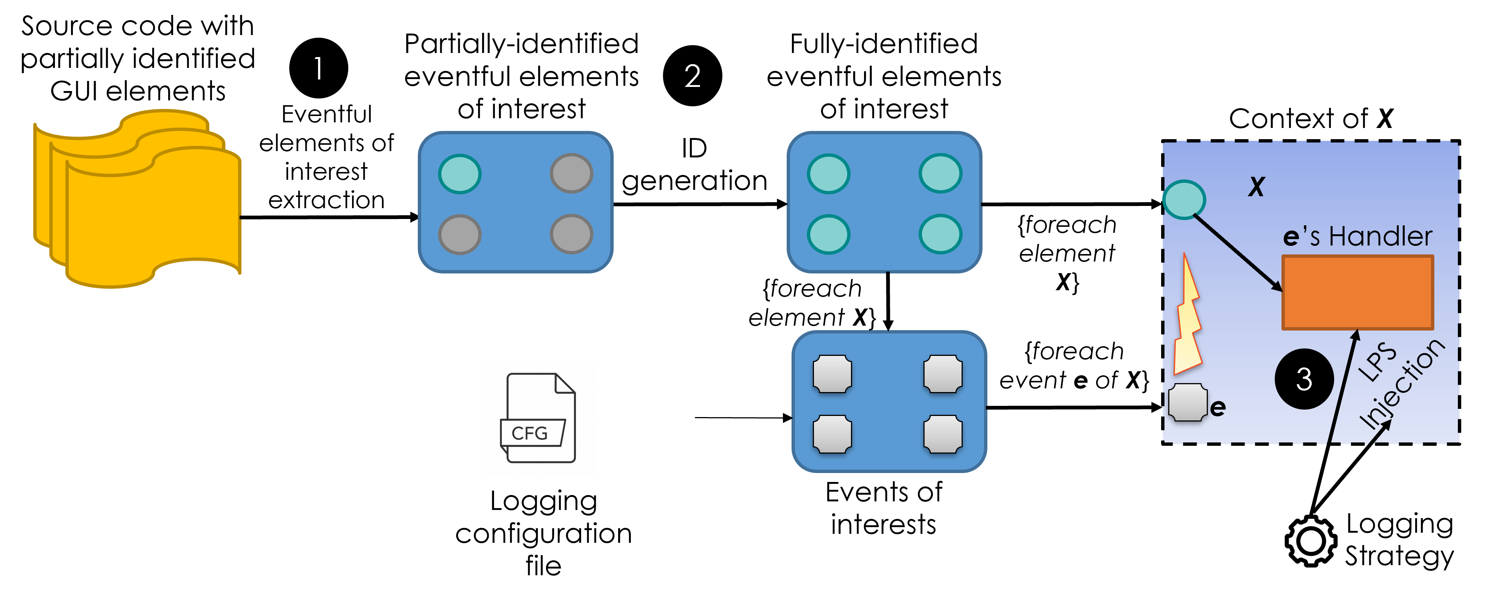
SoftScanner – Event-based GUI Widgets Logging (2)
Software Logging and Observability
32

Slide 33

SoftScanner – Event-based GUI Widgets Logging (3)
Software Logging and Observability
33

Slide 34
Software Observability – Limitations of Software Logging
Overwhelming Volume and Verbosity
Impact on Performance and Costs
Real-time Analysis Limitations
Massive volumes of data make it difficult to store and manage logs efficiently
High verbosity can obscure important information, making it hard to extract actionable insights
Logging at a granular level can incur performance overhead
Storing and processing large volumes of logs can lead to increased storage and processing costs
Logs are not always suitable for real-time analysis due to processing delays
It is challenging to set up real-time alerts based on log data without a significant investment in tooling
Logs in Isolation Lack Context
Logs Fall Short on User Journey Insights
Troubleshooting Complexities
Logs often provide limited context when viewed in isolation
Correlating logs across services in a distributed system can be challenging without proper tools
Logs typically don’t capture the end-to-end user journey or transaction flow
Understanding user behavior or transaction performance is difficult with logs alone
Sifting through logs to identify issues is time-consuming and often requires expert knowledge
Without structured logs, troubleshooting can become a needle-in-a-haystack scenario
Software Logging and Observability
34

Slide 35
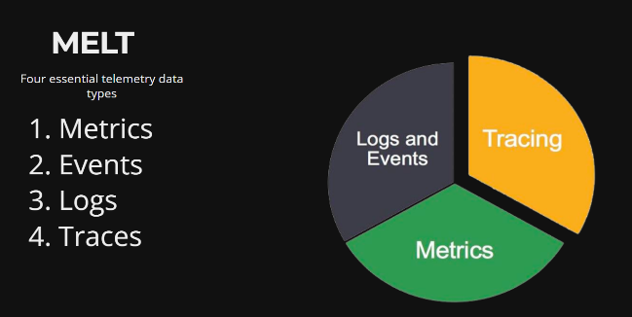
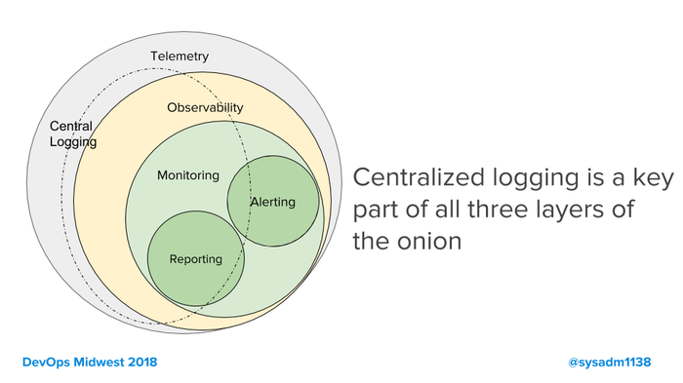
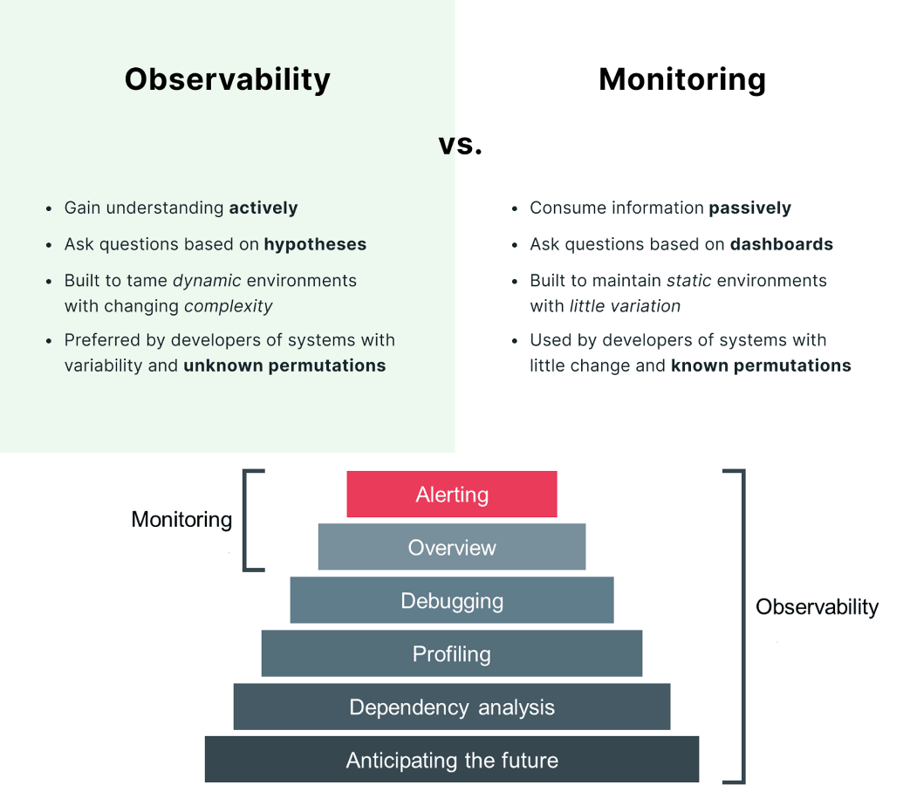
Software Observability – Introduction
Observability is concerned with understanding what’s going on internally in a system based on its outputs.
Observability implies implementing a MELT strategy
Telemetry is the collection of measurements or other data at remote points and their automatic transmission to receiving equipment for further processing.
Telemetry data includes MELT and extends to all other data created by a system.
SoftScanner: A Log-centric Software Analysis and Engineering Ecosystem
35

Slide 36
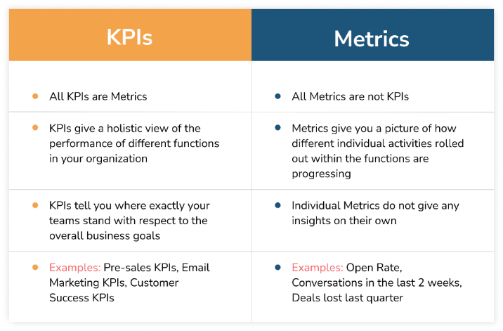
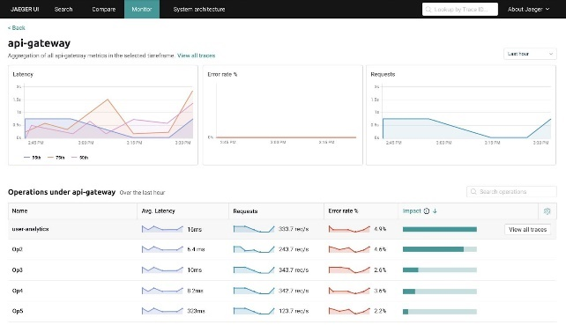
Software Observability – Metrics
Metrics are measurements collected at regular intervals. It can be error rate, response time, CPU mean usage, etc.
SoftScanner: A Log-centric Software Analysis and Engineering Ecosystem
36

Slide 37
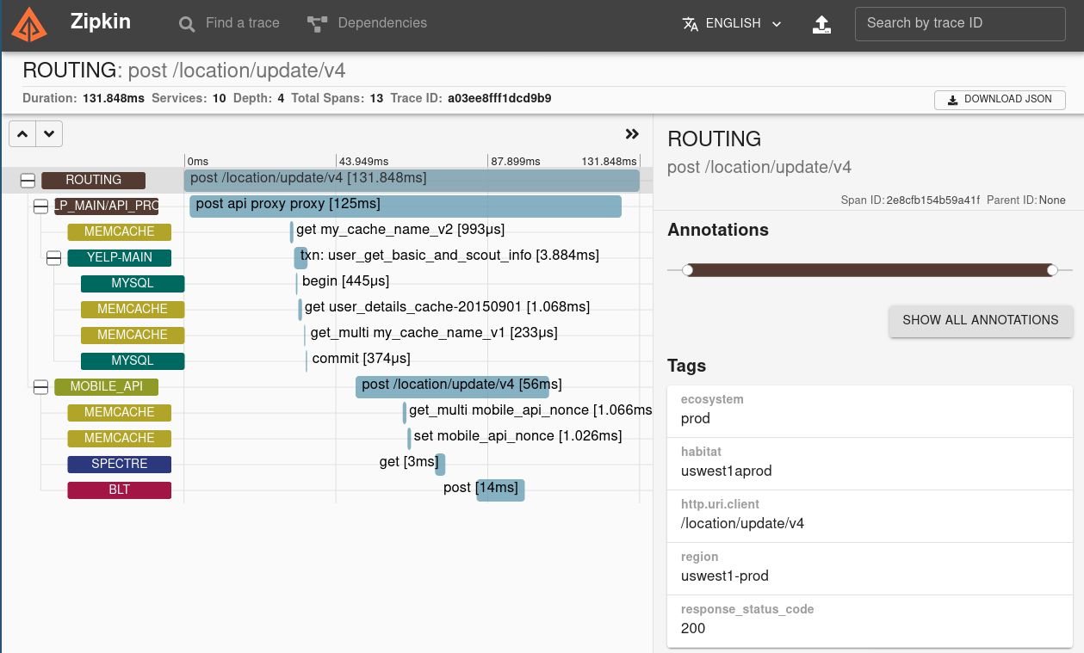
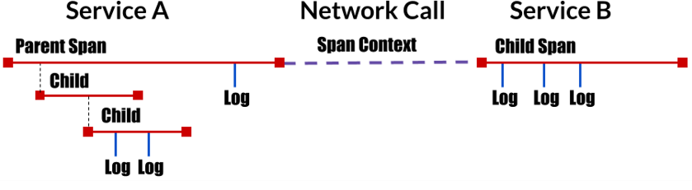
Software Observability – Traces
Traces are a collection of spans covering operations occurring during the completion of an end-to-end request to reconstitute what happened. Traces can be potentially augmented with logs.
A span is a discrete unit of work that is tracked within a trace. A trace, therefore, is a series of causally related and potentially nested spans covering an end-to-end request within a system.
SoftScanner: A Log-centric Software Analysis and Engineering Ecosystem
37

Slide 38
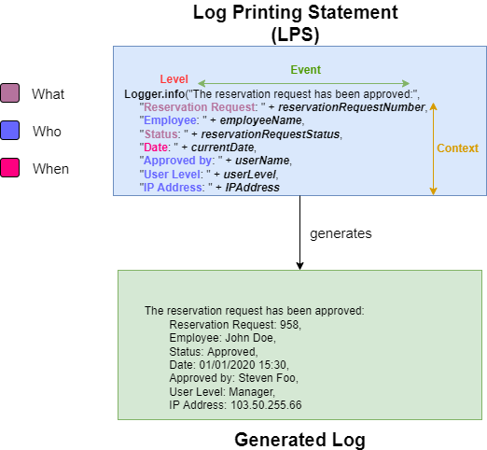
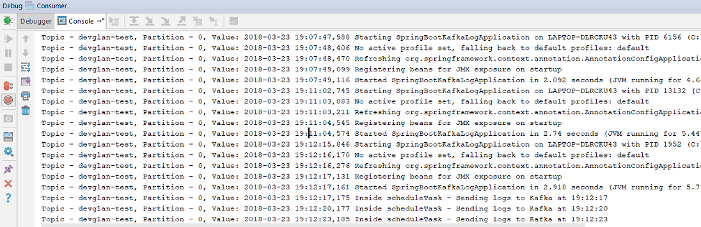
Software Observability – Logs
Logs are a collection of events generated by Log Printing Statements (LPS) into the code. An LPS can be added manually or automatically instrumented into the code.
Logs provide micro-level details and context about a specific span while traces provide macro-level details and context across multiple spans
SoftScanner: A Log-centric Software Analysis and Engineering Ecosystem
38

Slide 39

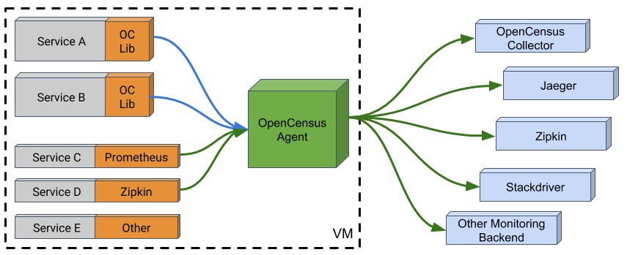
Software Observability – Industry Standards: OpenTracing and OpenCensus (In the past)
SoftScanner: A Log-centric Software Analysis and Engineering Ecosystem
39

Slide 40
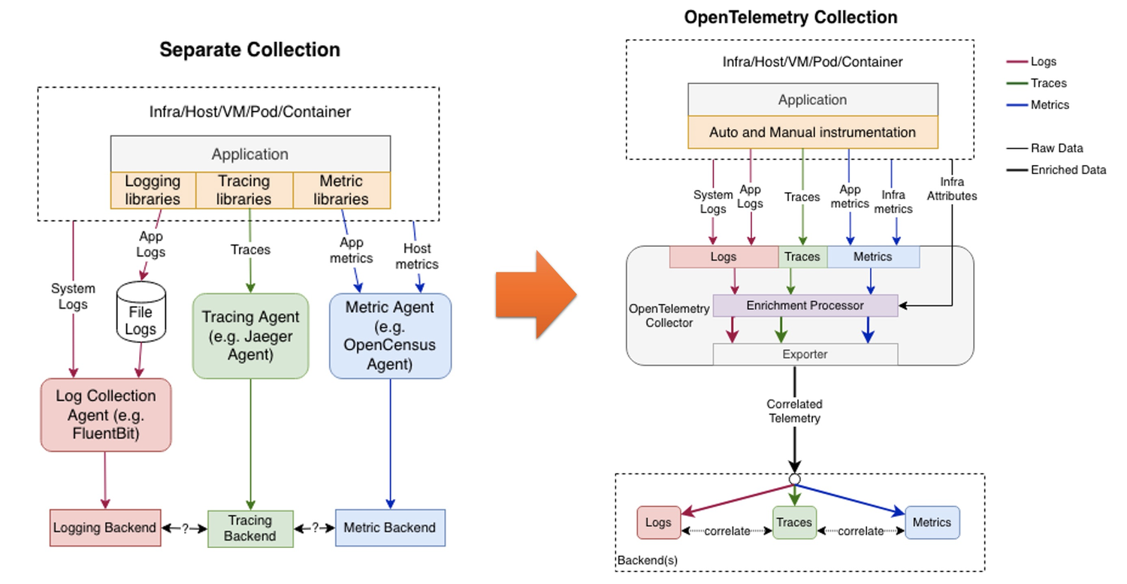
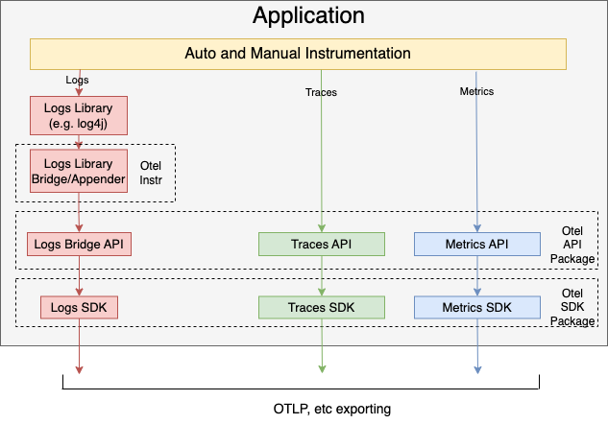
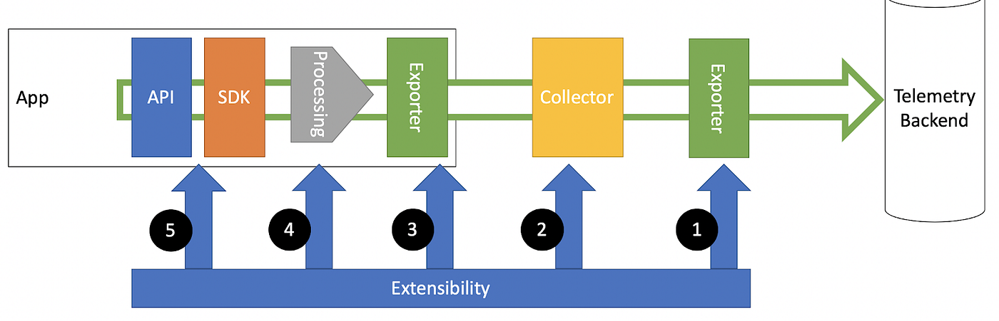
Software Observability – Industry Standards: OpenTelemetry (Now)
SoftScanner: A Log-centric Software Analysis and Engineering Ecosystem
40

Slide 41
SoftScanner – OpenTelemetry Tracing with Zipkin
Software Logging and Observability
41

Slide 42

Thank you for your attention! Any questions?
Software Logging and Observability
42

